Slide 1
Mathematical Formula Extractor and Evaluator
Extracting and Solving Mathematical Expressions from Images

Slide 2
Table of Contents
Objective
Tools and Libraries
Application Workflow
Image Preprocessing
OCR and Text Extraction
Formula Parsing
Evaluation and Solving
Challenges and Solutions
Future Enhancements

Slide 3
Objective
To Develop an application that can automatically extract and solve mathematical formulas from images. The program will:
Accept an image with printed or handwritten formulas.
Use OCR to identify and extract mathematical expressions.
Parse, evaluate, and solve these expressions.
Display results through a command-line or simple graphical interface.

Slide 4
Tools and Libraries
Tesseract OCR: For text extraction from images.
SymPy: For symbolic mathematics, parsing, and solving equations.
OpenCV: For image handling and preprocessing (improves OCR accuracy).

Slide 5
Application Workflow
The application takes an image file containing mathematical formulas as input.
Enhances the image (e.g., converting to grayscale) to improve text detection accuracy.
Uses OCR to extract formulas from the image as text.
Processes the extracted text to identify and structure mathematical expressions.
Parses and evaluates or solves the formulas using mathematical tools.
Shows the final solutions or evaluations either on the command line or in a GUI window.

Slide 6
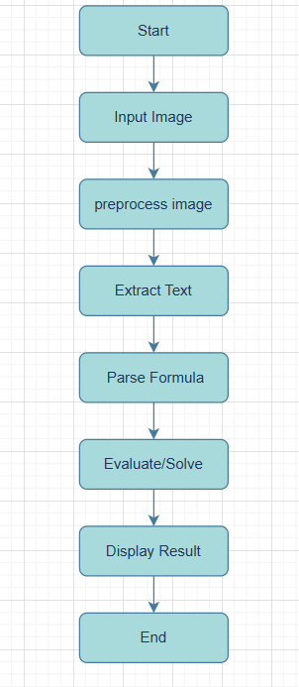

Slide 7
Image Preprocessing
To improve the accuracy of text extraction (OCR), we preprocess the input images using simple enhancement techniques:
Grayscale Conversion: Converts the image to black and white, removing color details to make text more distinct.
Thresholding: Turns the image into a binary format (black and white) by setting a pixel intensity threshold, which helps to clearly separate text from the background.
These steps make it easier for the OCR tool to recognize and extract mathematical formulas accurately.

Slide 8
OCR and Text Extraction
Extract text, specifically mathematical formulas, from images.
Tesseract OCR, which converts image-based text into editable text.
Load the input image and apply any necessary preprocessing to enhance text visibility.
Use Tesseract OCR to scan the image and extract text line-by-line.
Filter and clean the OCR output to isolate mathematical formulas.

Slide 9
Formula Parsing
Fix Multiplications:
Use regular expressions insert * between numbers and variables
Eg: 2(x) becomes 2*x
Sympify Expressions:
Convert string formulas to SymPy expressions for accurate evaluation and solving.
Equation Splitting :
Separate expressions on either side of = o set up equations for solving.

Slide 10
Evaluation and Solving
Evaluation:
If no variables are detected, evaluate the expression numerically.
Solving:
For equations with variables, use SymPy’s solving functions.
Handle special cases, such as trigonometric and logarithmic functions.
Output:
Display solutions or evaluated results for each extracted formula.

Slide 11
Challenges and Solutions
Challenges:
OCR inaccuracies, especially with handwritten text.
Parsing complex formulas correctly
Differentiating between similar symbols
Solutions:
Preprocess images to improve OCR accuracy
Use regex patterns and SymPy for better formula parsing
Enhance error handling for complex or ambiguous cases

Slide 12
Future Enhancements
Enhanced Handwriting Recognition:
Train on diverse handwriting samples
Improved Preprocessing:
Use adaptive thresholding or noise reduction for OCR
Advanced GUI Features:
Add support for multiple formulas and interactive plotting.
Support for More Complex Math:
Expand to support calculus, matrices, and integrals.

Slide 13
Conclusion
To extract mathematical formulas from images and evaluate them using advanced tools like Tesseract OCR and SymPy.
By integrating image processing and symbolic mathematics, this application provides a valuable resource for students and professionals alike. Future enhancements could improve accuracy and expand its capabilities, making it an even more powerful tool for solving complex mathematical problems.

